Slide 1

Towards sustainable energy management : Federated Learning
By
Vatsa Khatri (BT21CSE006)
Prajwal Sam Rachapudy (BT21CSE015)
Harsh Deshmukh (BT21CSE020)
Rashmi Sharma (BT21CSE022)
Under guidance of
Dr. PVN Prashanth

Slide 2
Review of last evaluation/Where we left last time
We encountered two challenges with FL:
1) Handling Asynchronous Clients
2) Data Heterogenity

Slide 3
Review of last evaluation/Where we left last time
Solution to Asynchronous Challenge
Directed Acyclic Graph (DAG) Approach
C1
S
C2
C3
(Updated DAG)

Slide 4
Structure of Node in the DAG
The updated model parameters (coefficients and intercept)
Client ID
TimeStamp
Latitude, Longitude(Location of the client)
Structure of a Node

Slide 5
Client-Client Relation

Slide 6
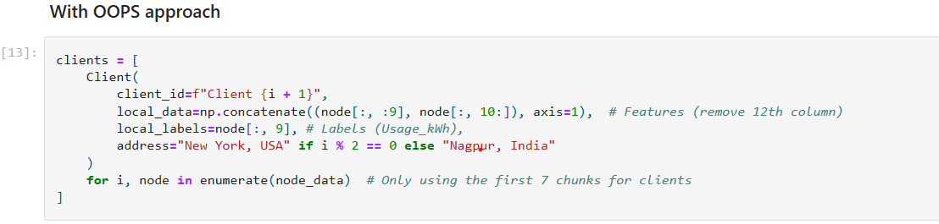
Implementing DAG Approach
We are initialising a list of clients where each client is an independent object of the Client class (which will be discussed later in this presentation).
In the client object, we are adding an address field to apply the proximity approximation.

Slide 7
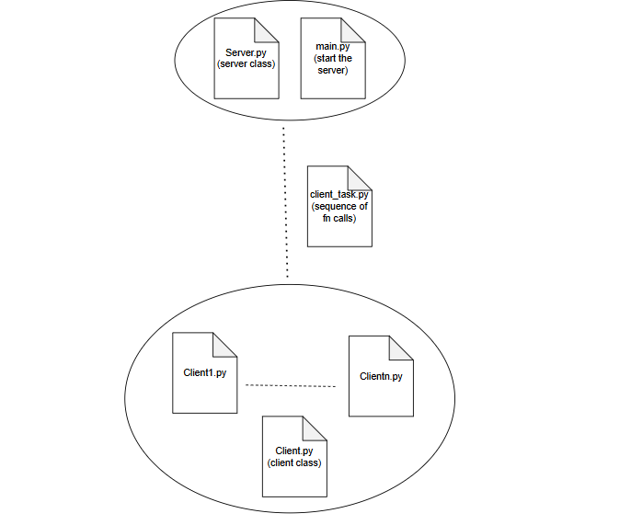
A Realistic CLient Server Approach: Better Solution

Slide 8
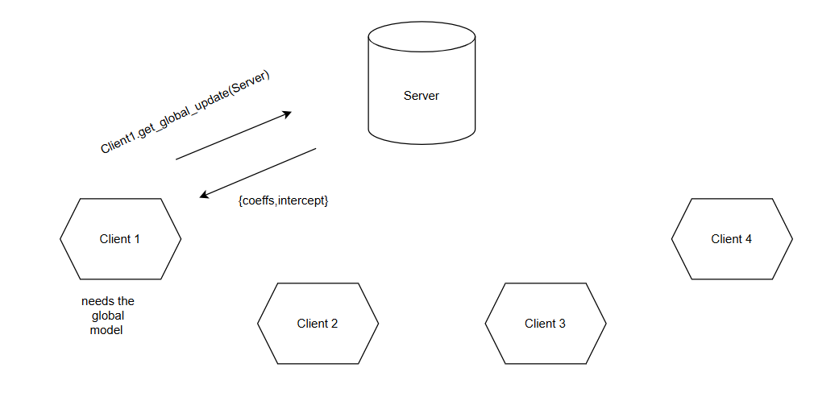

Slide 9
THANK YOU

